Slide 1
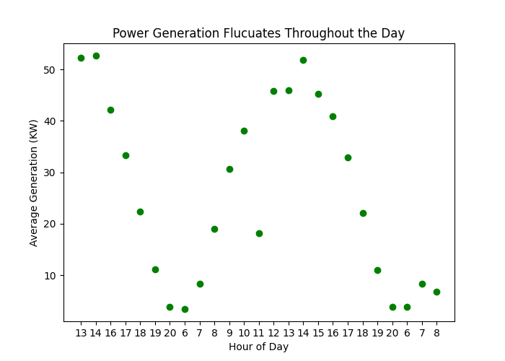
Solar Energy Forecasting Using Weather data and Machine Learning methods
Problem Description: Predict one hour of Solar Energy generation, Given weather observation(or weather forecast for predictions)
Motivation: In order to effectively manage the fluctuation solar power generation with integration of the grid, We need to know how much power will be produced in the future.

Slide 2
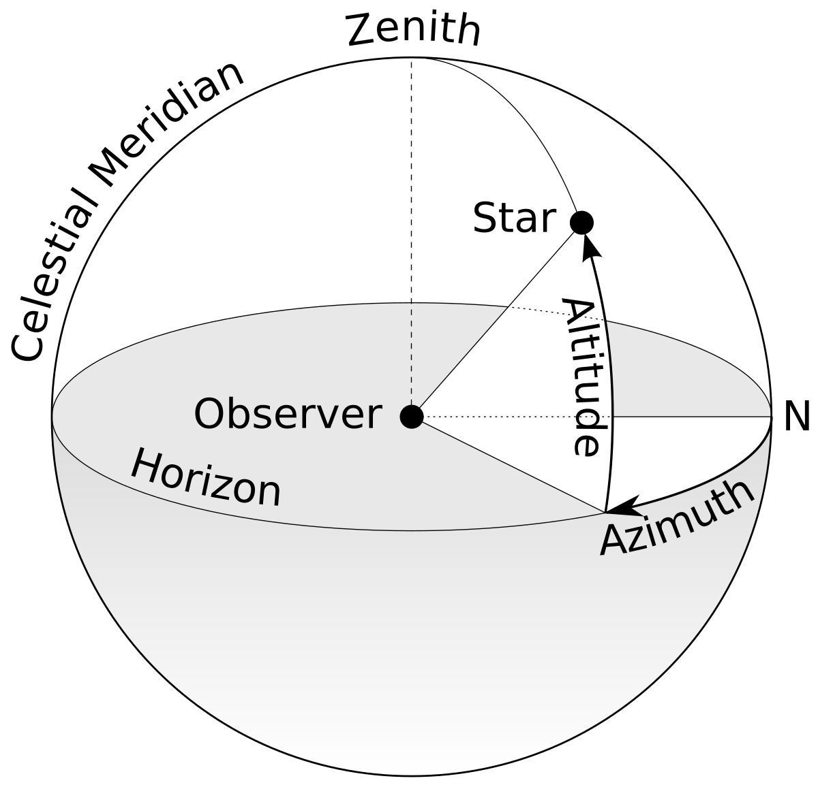
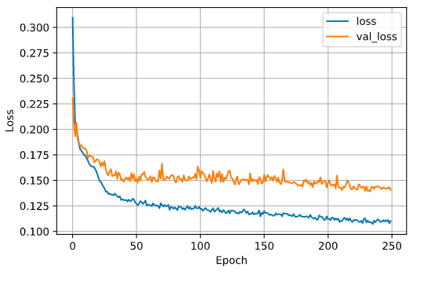
Progress
Data Wrangling (Biggest Challenge)
31% of total data was Corrupted
Affected 44% of hours
Hours have different number of data points
Weather Station has several days of missing data
Supplemented Weather with Solar Coordinate Angles (Elevation, Azimuth, Zenith)
Experimented using Total Generation and average Generation
Have Done Learning Using Several Regression Methods
0.85/0.15 Test/Train Split
Scaled Both Input and Output Data

Slide 3
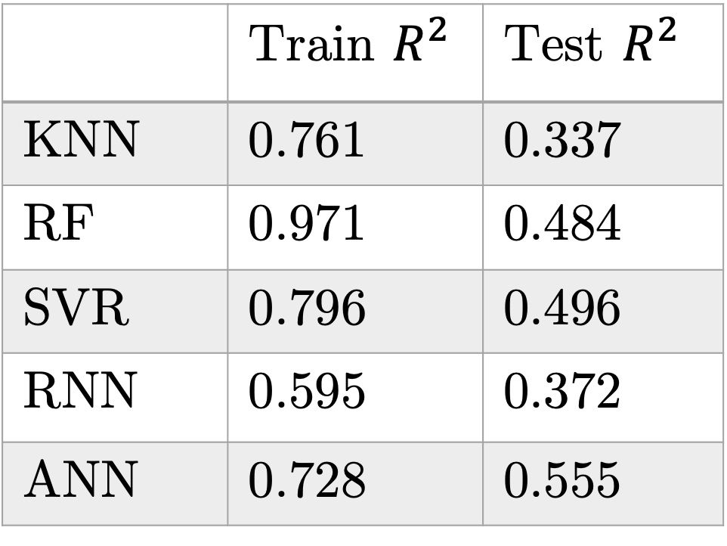
Results (on total solar)
 | Train $R^{2 }$ | Test $R^{2}$
KNN | 0.761 | 0.337
RF | 0.971 | 0.484
SVR | 0.796 | 0.496
RNN | 0.595 | 0.372
ANN | 0.728 | 0.555
K-Nearest Neighbors(KNN)
Random Forest (RF)
Support Vector Regression (SVR
Recurrent Neural Network (RNN)
{L10, L10, 10, 1}, Adam, lr 0.001, batch size 64, epochs 250, dropout 0.2
Artificial Neural Network (ANN)
{20, 10, 1} Adam, lr 0.001, batch size 50, epochs 400, dropout 0.2

Slide 4
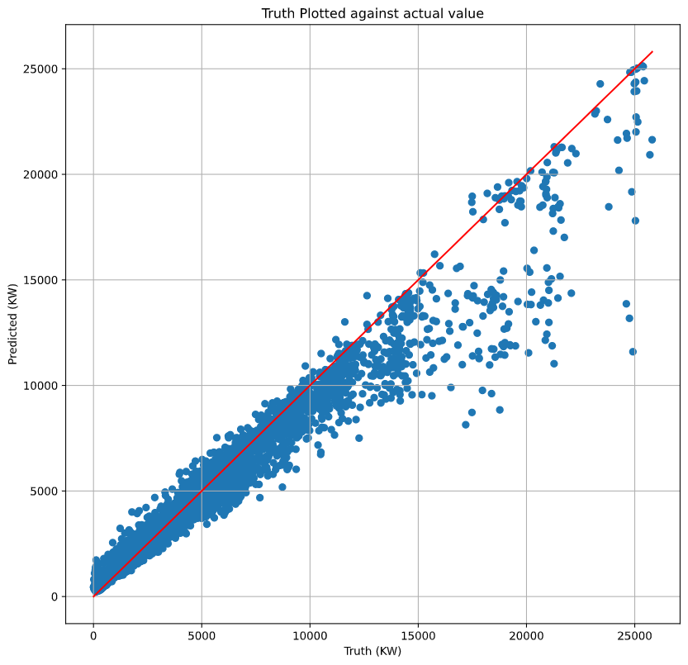
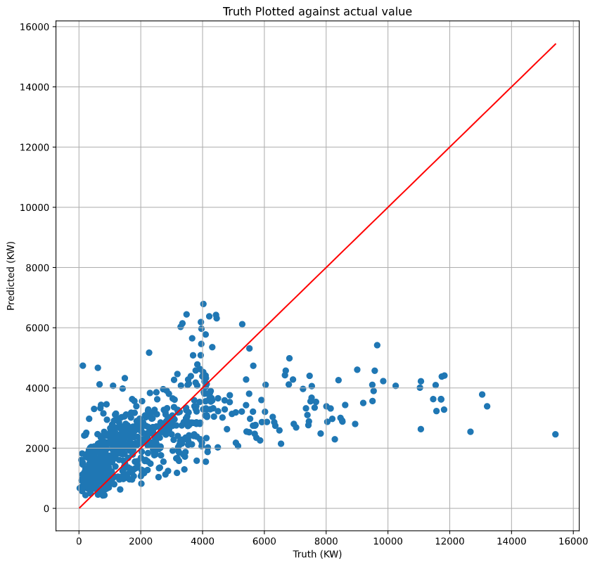
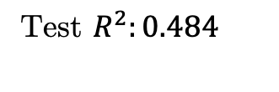
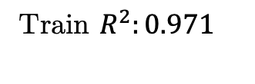
Results on Total Prediction (RF)
Train $R^{2}:0.971$
Test $R^{2}:0.484$

Slide 5
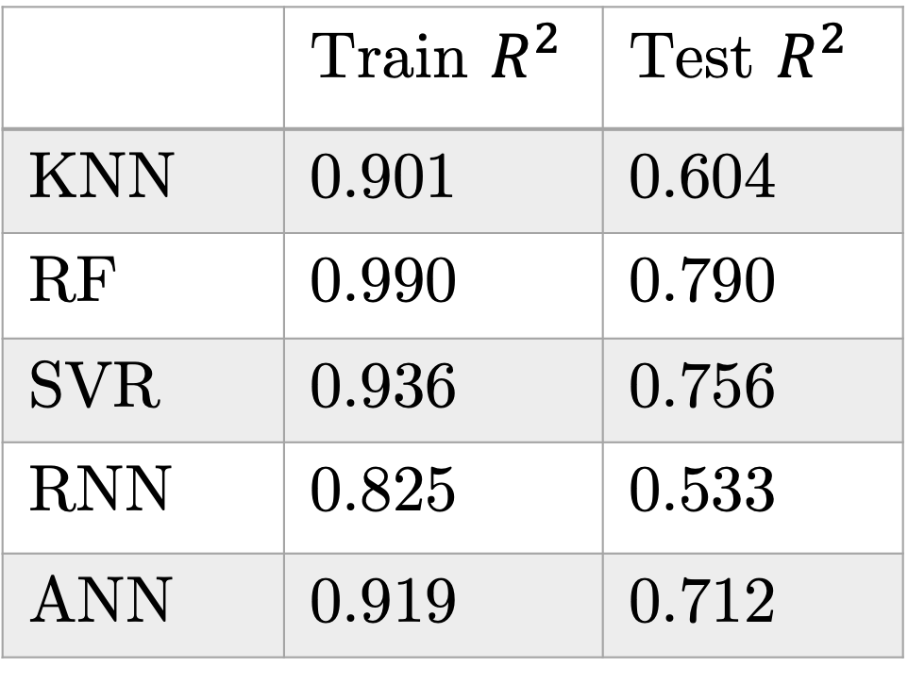
Results (on average solar)
 | Train $R^{2 }$ | Test $R^{2}$
KNN | 0.901 | 0.604
RF | 0.990 | 0.790
SVR | 0.936 | 0.756
RNN | 0.825 | 0.533
ANN | 0.919 | 0.712
K-Nearest Neighbors(KNN)
Random Forest (RF)
Support Vector Regression (SVR
Recurrent Neural Network (RNN)
{L10, L10, 10, 1}, Adam, lr 0.001, batch size 50, epochs 250, dropout 0.2
Artificial Neural Network (ANN)
{20, 10, 1} Adam, lr 0.001, batch size 50, epochs 400, dropout 0.2

Slide 6
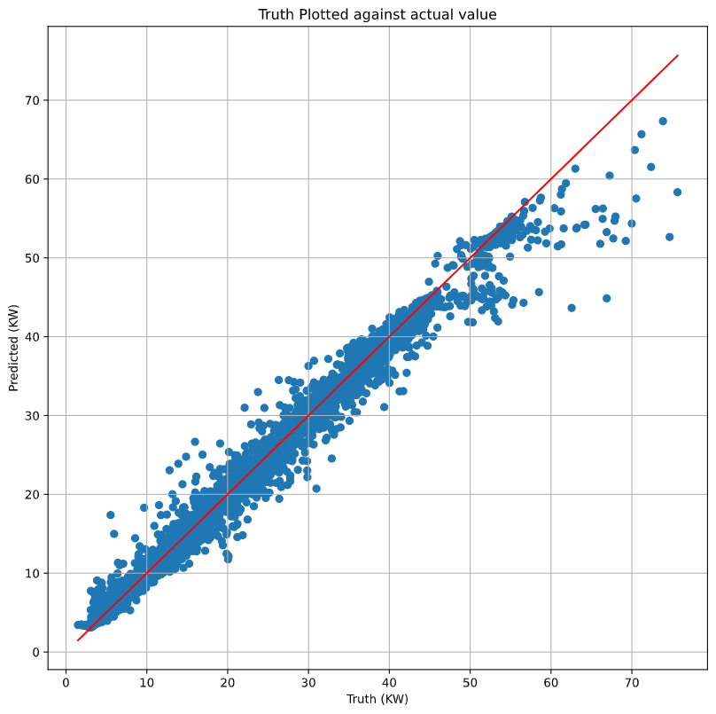
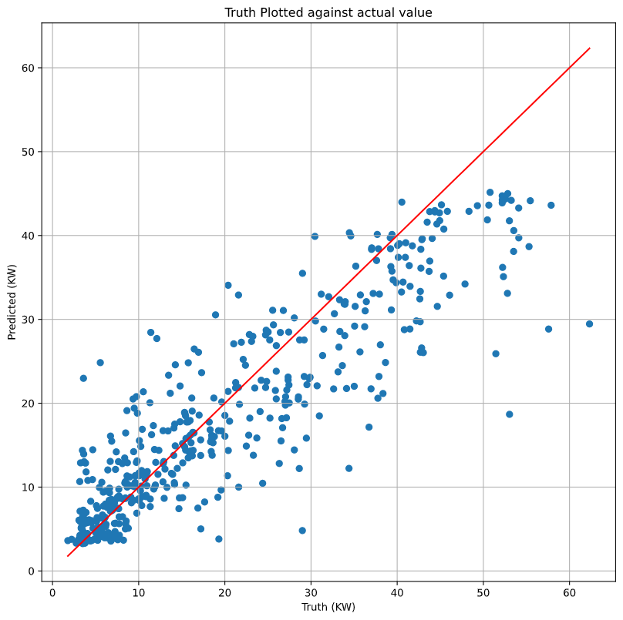


Results on Average (RF)
$$R^{2}:0.990$$
$$R^{2}:0.768$$

Slide 7
Next Tasks
Based on Research Papers’ methods:
Split data into seasons and do separate regressions [1]
Rolling average based on hour of day [2]
Add Evaluation metrics of RMSE, and MAE [1, 2, 3]
PCA (if time) [3]
For the Class:
Poster
Paper

Slide 8
Resources
[1] E. Isaksson, M. Conde. “Solar Power Forecasting with Machine Learning Techniques”. 2018.
[2] J. Torres, et al. “Deep Learning for Big Data Time Series Forecasting Applied to Solar Power”. Advances in Intelligent systems and Computing. 2019.
[3] “Forecasting of Solar Energy with Application for a Growing Economy Like India: Survey and Implication”. Renewable and Sustainable Energy Reviews. 2017.

